Slide 1







Student
user-friendly
guide
INSTRUCTOR
admin staff
university management system edition

Slide 2

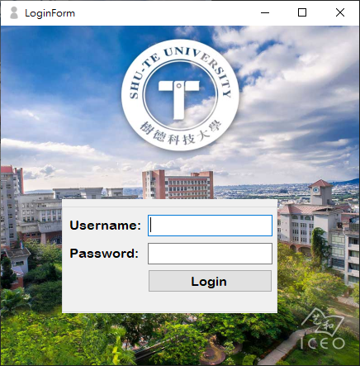
login form
The login form helps users securely access the database system. By entering their username and password, users can verify their identity, protect sensitive information, and reach the correct dashboard for their role. This ensures that only authorized users can view or update records.

Slide 3

Student
guide for
students
INSTRUCTOR
admin staff

Slide 4

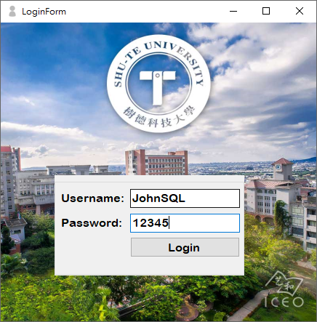
access flow
To access the system, users must enter their username and password. After providing these credentials, they simply click the Login button to continue.

Slide 5

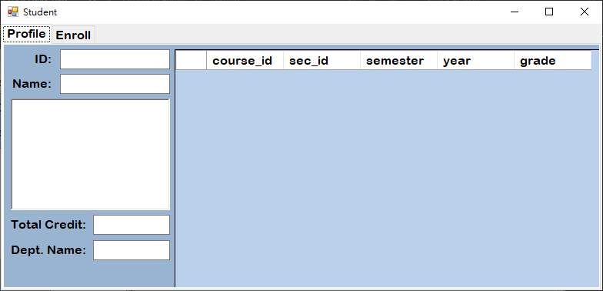
STUDENT FORM
If the user is a student, the system will redirect them to the Student Form, where they can view and manage their academic information. This form provides access to essential details such as enrolled courses, grades, and department records, helping students stay organized. By guiding students directly to their personalized dashboard, the system ensures secure access and smooth navigation for academic tasks.

Slide 6

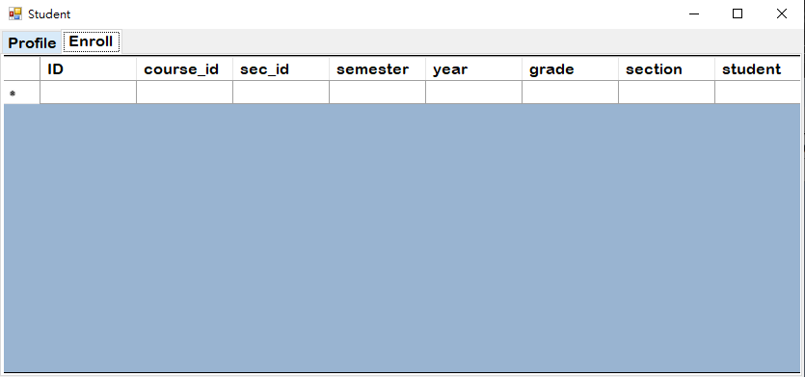
enroll
In this section, students can track the courses they have successfully enrolled into, providing a centralized view of their current and historical academic schedule.

Slide 7
Student
guide for
instructors
INSTRUCTOR
admin staff

Slide 8
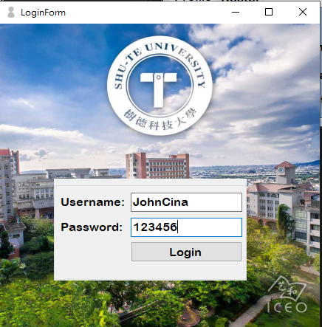
access flow
To access the system, users must enter their username and password. After providing these credentials, they simply click the Login button to continue.

Slide 9
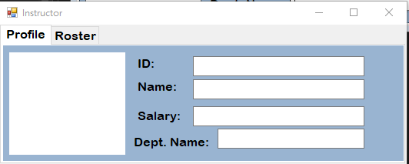
INSTRUCTOR FORM
If the user is an instructor, the system will redirect them to the Instructor Form, which provides tools for managing teaching responsibilities.

Slide 10
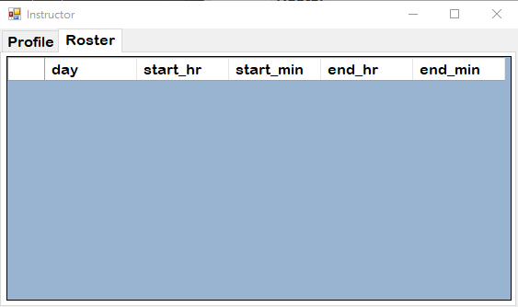
roster
Here, instructors can view assigned courses, and monitor class schedules. This role-based access ensures that instructors have the resources they need to efficiently support student learning.

Slide 11
Student
guide for
administrative staffs
INSTRUCTOR
admin staff

Slide 12
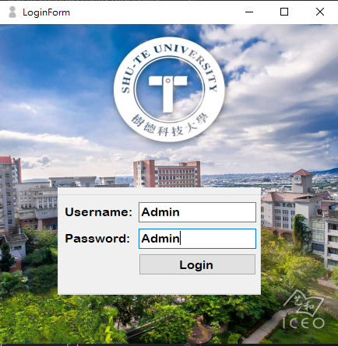
access flow
To access the system, users must enter their username and password. After providing these credentials, they simply click the Login button to continue.

Slide 13
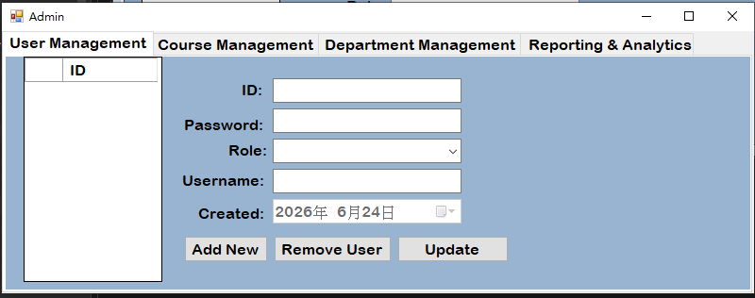
ADMIN FORM
If the user is an administrator, the system will redirect them to the Admin Form, designed for managing the overall database system. Administrators can oversee departments, allocate budgets, and maintain system security. This ensures that the institution’s data remains accurate, protected, and well-organized for all users.

Slide 14
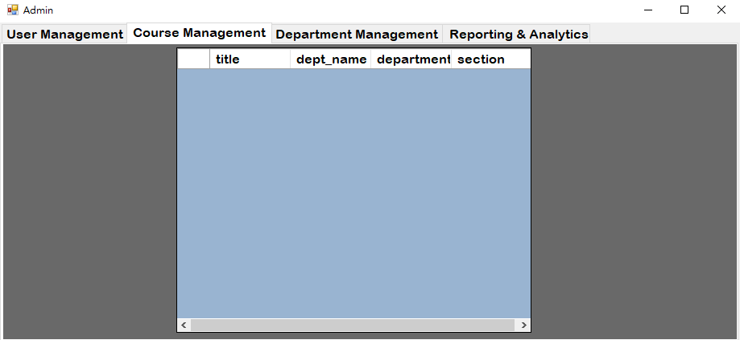
course management
The Course Management tab allows administrators to view, edit, and delete course records stored in the database. To modify a course, select it from the table, update the necessary fields such as title, department, or assigned instructor, then click Save to confirm.

Slide 15
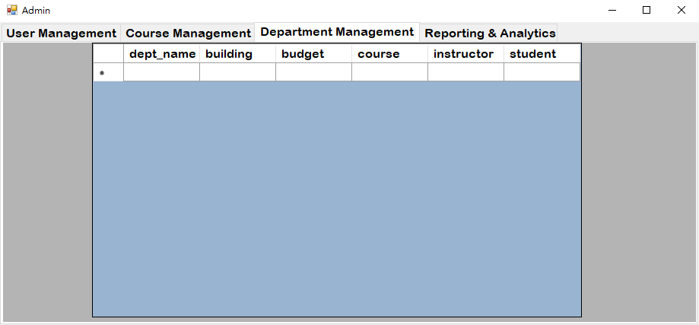
department management
The Department Management tab gives administrators a complete overview of all university departments, displaying each department's name, building, budget, and linked courses, instructors, and students. Admins can add a new department by filling in the required fields and clicking Add New, or update existing records by selecting a department and clicking Save. Any changes made across the system will automatically reflect here, keeping all department data organized and accurate at all times.

Slide 16
challenges & limitATIONS
Real-time collaboration through GitHub
Navigating SQL and Visual Studio
Coding errors
Limited programming knowledge

Slide 17
CONCLUSION
We have come a conclusion that SQL is important in Despite limited initial programming knowledge, navigating the complexities of Visual Studio, SQL, and GitHub ultimately fostered rapid technical growth and disciplined team collaboration. Overcoming frequent coding errors and merge conflicts shifted the team's focus from merely writing code to mastering resourcefulness and iterative debugging. Ultimately, the project concluded not just with a functional technical asset, but with a proven ability to adapt and problem-solve through complex development hurdles.

